Slide 1
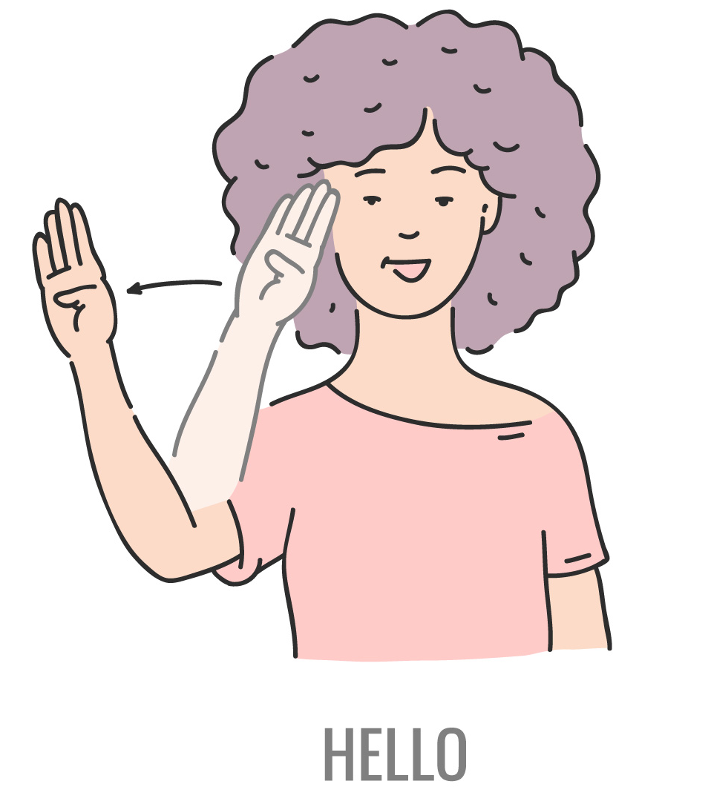
Real-Time Sign Language Interpretation Using Image Recognition
Yuktha Priya Masupalli
J01221806

Slide 2

Problem Statement
Sign language is a manual type of communication commonly used by deaf and mute people. It is not a universal language, so many deaf/mute people from different regions speak different sign languages. So, this project aims to improve the communication between deaf/mute people from different areas and those who cannot understand sign language.
Using deep learning methods which can improve the classification accuracy of sign language gestures.

Slide 3
Abstract
In today’s world, communication barriers for the hearing impaired persist, especially with those unfamiliar with sign language.
This project proposes a real-time American Sign Language (ASL) interpreter using deep learning and image recognition.
This approach addresses inclusivity and accessibility, laying the groundwork for future advancements like multi-language support and emotion detection.”

Slide 4
Introduction
Millions of individuals worldwide face communication barriers due to hearing impairments. Approximately 430 million people experience disabling hearing loss, often leading to social isolation and discrimination.
The deaf community relies heavily on sign language, yet many people lack proficiency in it, resulting in significant communication challenges.
To develop a system that can recognize ASL gestures in real-time and translate them to text or audio, enhancing communication between deaf and hearing individuals.

Slide 5
Existing System
Traditional human interpreters are often expensive and not always available, especially in emergencies.
Basic mobile applications struggle with real-time recognition and nuanced gestures, frequently failing to support American Sign Language (ASL) effectively.
Wearable technology faces adoption barriers due to high costs and technical complexities.

Slide 6
Proposed System
The goal of this project is to develop an intuitive real-time ASL interpreter using image recognition technology.
The system will capture user gestures via a camera, process these images through deep learning algorithms, and convert them into text or audio output, facilitating seamless communication between deaf and hearing individuals.

Slide 7
Deep Learning Techniques
Convolutional Neural Networks (CNNs):
Excellent for image recognition tasks. They learn spatial hierarchies of features, making them ideal for recognizing gestures in sign language.
Implemented using TensorFlow or PyTorch.
Recurrent Neural Networks (RNNs):
LSTM networks can process sequences of images, capturing temporal dependencies crucial for understanding dynamic gestures.

Slide 8
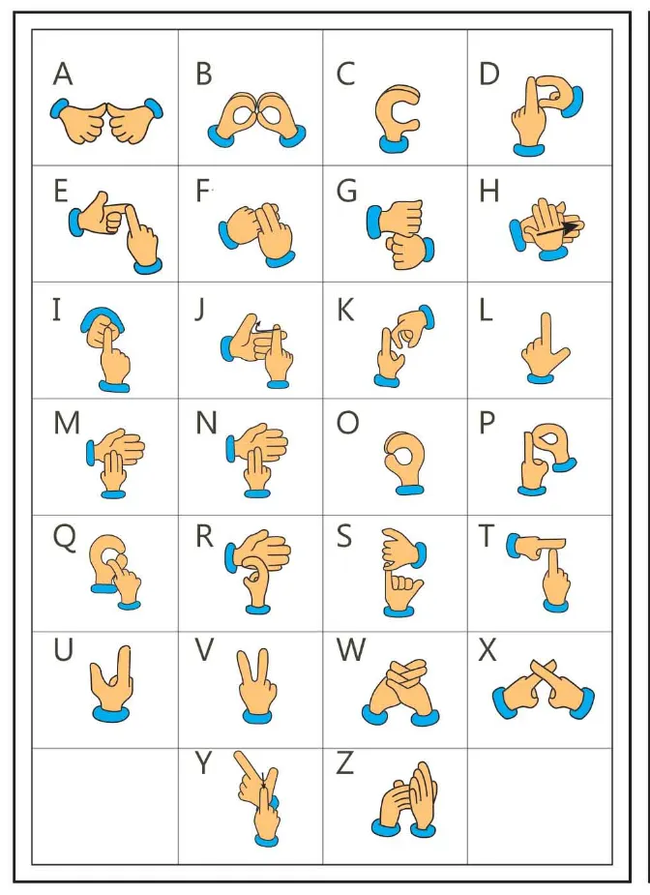
Dataset
Hand Gesture Image Data: High-resolution Hand Gesture images should make up the majority of the dataset. A variety of alphabets and numbers which are labeled with hand gestures averaging about 1200 images must be covered by these photographs. Here, I am using ASL Dataset from kaggle.
Image Labels: For the supervised learning approach to work, accurate alphabets and numeric labels are essential. The precise labels that each hand gesture image depicts will be identified by a clear label. To enable model training, a reliable and consistent labeling procedure will be adopted.

Slide 9
Future Scope
Text-to-speech integration for translating signs into audible speech.
Emotion detection to enhance communication nuances.
Support for multiple sign languages for broader inclusivity.

Slide 10
Thank You

